Slide 1
Senti-predict
IMDb-powered sentiment analysis
SUBMITTED BY :
S. SAI KIRAN
GEMBALI SAINATH
MATSA GUNA VARDHAN

Slide 2
CONTENTS
OBJECTIVE
INTRODUCTION
FEATURES
REQUIREMENTS
MODEL
SCOPE
FLOWCHART
CONCLUSION
OBJECTIVE

Slide 3
OBJECTIVE
The objective of the project is to create a user-friendly web application that utilizes a pre-trained machine learning model trained on IMDb movie reviews to provide users with efficient and reliable sentiment analysis of their input sentences. By harnessing the power of natural language processing, the project aims to enable users to gain valuable insights into the emotional tone of their text, facilitating better decision-making and understanding.
OBJECTIVE

Slide 4
INTRODUCTION
"Senti-predict" is a sentiment analysis project leveraging IMDb movie reviews to classify user-input sentences as positive or negative. Implemented as a web application using Flask, users submit sentences and are directed to themed pages based on sentiment analysis results. Utilizing a logistic regression model trained on IMDb data, the project offers an interactive experience with Batman-themed aesthetics, including loading animations and clickable links for seamless navigation, empowering users to swiftly discern sentiment nuances.
OBJECTIVE

Slide 5
FEATURES
Instant Sentiment Analysis: Quickly analyze the sentiment of input sentences.
IMDb Dataset Integration: Utilize a robust dataset of IMDb movie reviews for accurate analysis.
User-Friendly Interface: Navigate the web application with ease for a seamless user experience.
Swift Response: Obtain sentiment analysis results promptly for efficient decision-making.
Accessibility: Access the web application from any device with an internet connection.
OBJECTIVE

Slide 6
REQUIREMENTS
~Frontend~
HTML/CSS/JavaScript: Frontend technologies for designing and styling the web application.
Web browser: To access and interact with the web application.
OBJECTIVE

Slide 7
~ Backend ~
Python: Programming language used for backend development.
Web framework for building the web application.
Scikit-learn: Machine learning library for implementing sentiment analysis.
Pandas: Library for data manipulation and analysis (if using Excel dataset).
OBJECTIVE

Slide 8
~ Others ~
VS code: Integrated development environment (IDE) for coding and debugging..
Excel: Software for creating and managing datasets in Excel format
OBJECTIVE

Slide 9
MODEL
~Logistic Regression~
Logistic regression is a statistical method used for binary classification tasks, where the goal is to predict the probability of a binary outcome (e.g., positive or negative sentiment) based on one or more independent variables (features). Despite its name, logistic regression is a classification algorithm, not a regression algorithm.
OBJECTIVE

Slide 10
How are we going to use Logistic Regression in our model?
OBJECTIVE

Slide 11
~ Training ~
The model learns from a labeled dataset of IMDb movie reviews, where each review is associated with its sentiment label (positive or negative). Through this process, logistic regression discerns patterns in the textual data and optimizes its parameters to make accurate predictions about the sentiment of unseen sentences. This trained model serves as a reliable tool for evaluating the emotional tone of user-input sentences in real-time.
OBJECTIVE

Slide 12
~ Prediction ~
When the user inputs a sentence, the logistic regression model swings into action. The sentence undergoes preprocessing steps similar to those applied during training. Then, the preprocessed sentence is fed into the trained model, which computes the probability that the sentence belongs to either the categories. This probability score, derived from the logistic function, serves as a measure of confidence in the model's prediction.
OBJECTIVE

Slide 13
~ Display ~
The web application then leverages this predicted sentiment to provide an informative user experience. Based on the sentiment probability obtained, the application directs the user to a dedicated positive or negative-themed page.
OBJECTIVE

Slide 14
SCOPE
The project's scope includes developing a web-based sentiment analysis application using a pre-trained logistic regression model. We'll utilize the IMDb movie reviews dataset for training, ensuring accurate predictions. Users can input sentences via an intuitive interface and receive real-time sentiment analysis results. Our focus is on efficiency, accuracy, and user experience enhancement. The project also allows for potential scalability and future customization with additional features or datasets.
OBJECTIVE

Slide 15
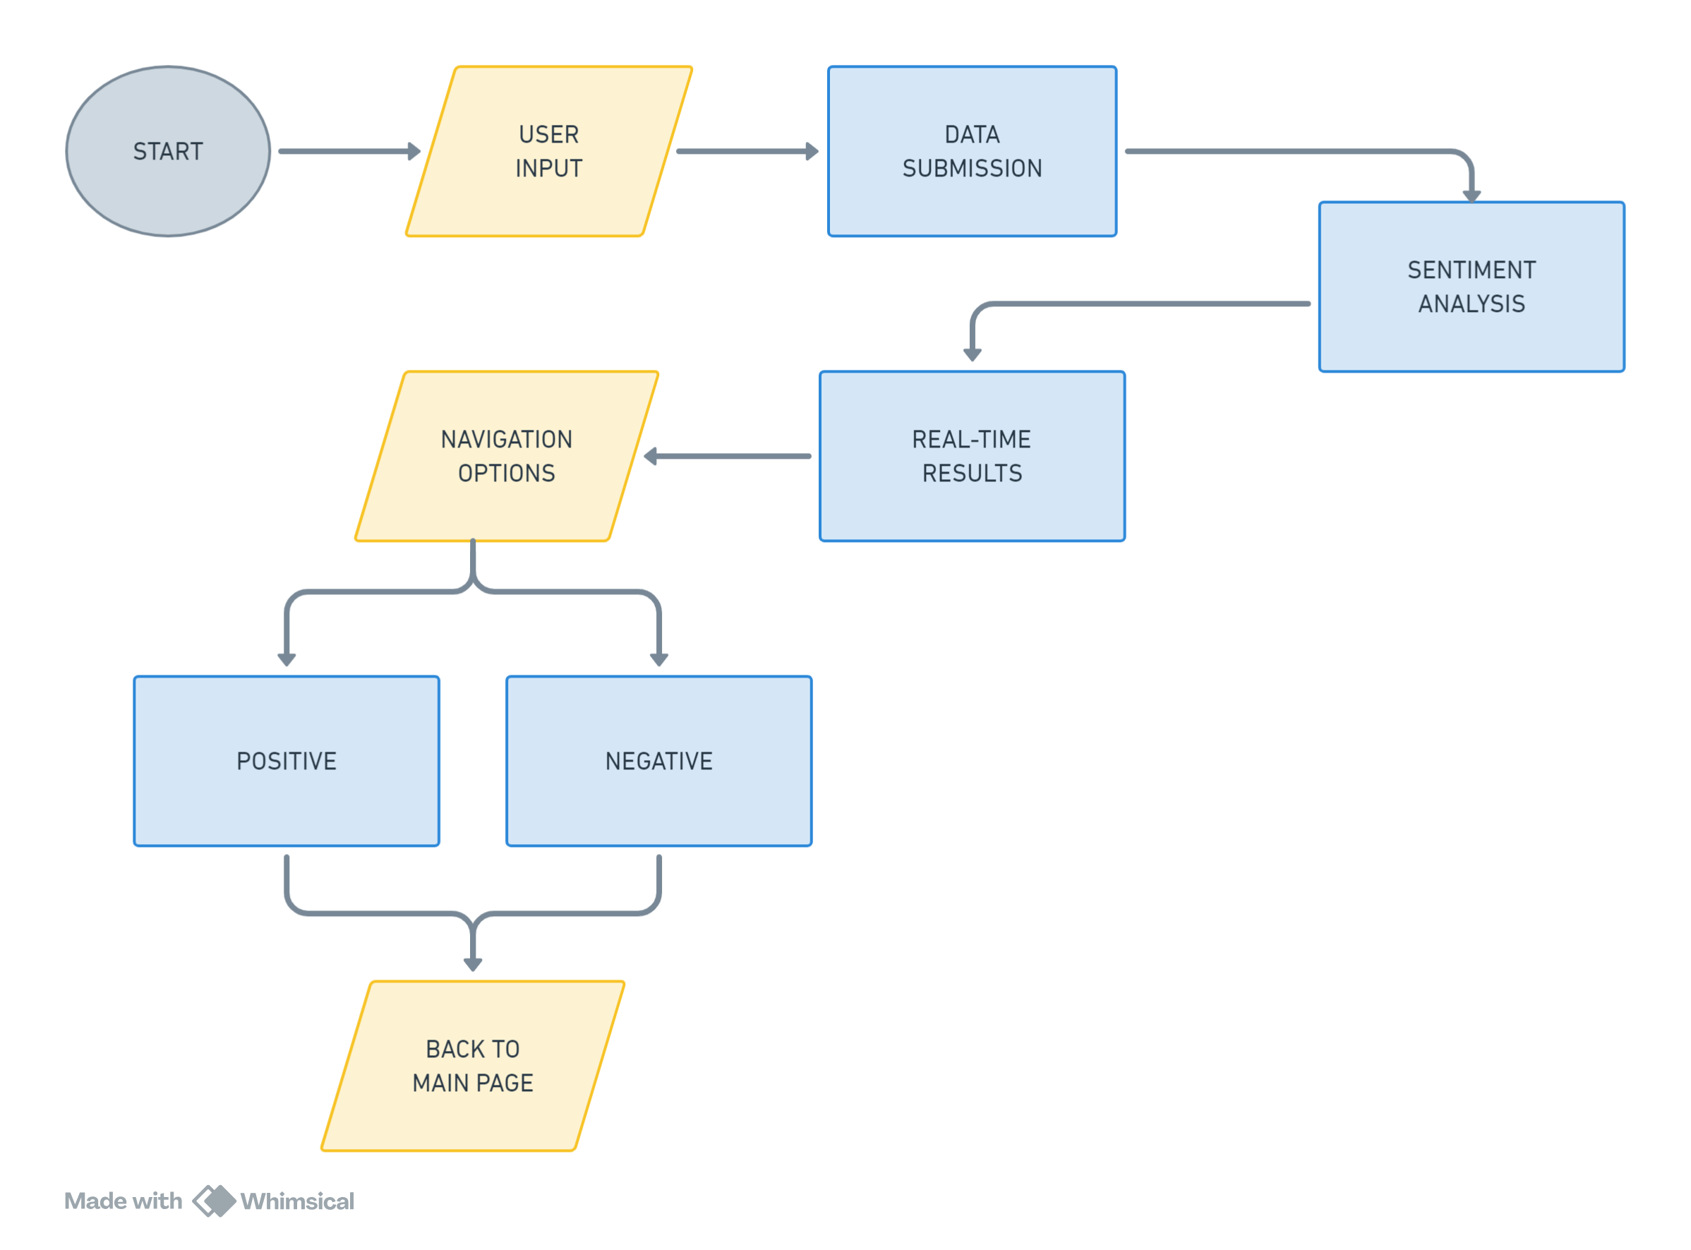
FLOWCHART
OBJECTIVE

Slide 16
CONCLUSION
The IMDb Sentiment Analysis project seamlessly combines web development and machine learning, offering users a user-friendly platform to assess sentiments in their input sentences within the context of IMDb movie reviews. By leveraging HTML, CSS, JavaScript, Flask, and TensorFlow/Keras, it provides a quick, intuitive, and locally deployable tool for users to explore the emotional nuances associated with their expressions in the cinematic realm
OBJECTIVE

Slide 17
IMDb-powered sentiment analysis
The IMDb Sentiment Analysis project seamlessly combines web development and machine learning, offering users a user-friendly platform to assess sentiments in their input sentences within the context of IMDb movie reviews. By leveraging HTML, CSS, JavaScript, Flask, and TensorFlow/Keras, it provides a quick, intuitive, and locally deployable tool for users to explore the emotional nuances associated with their expressions in the cinematic realm
THANK YOU
CONCLUSION

